Slide 1
Annex 2: sample location Zubieta
May 2024

Slide 2

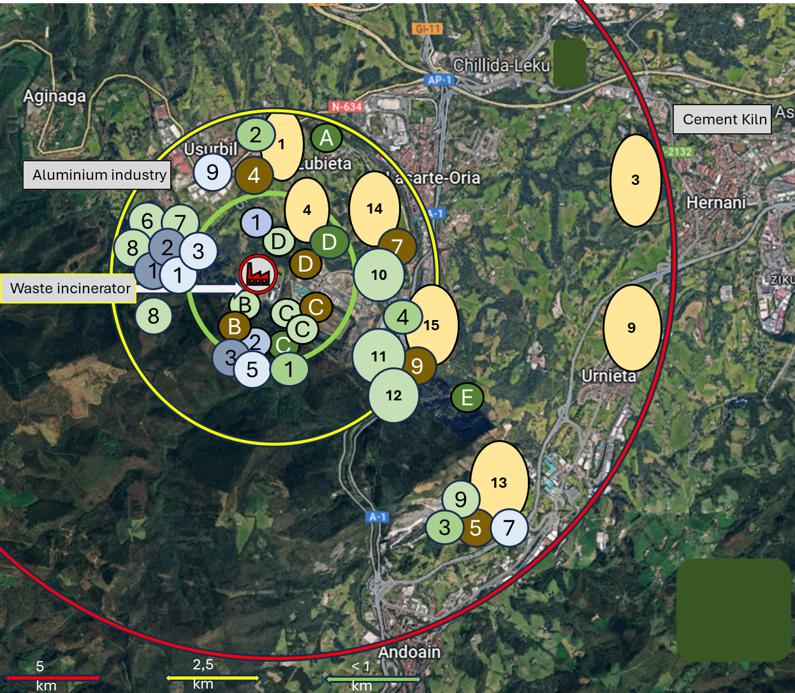
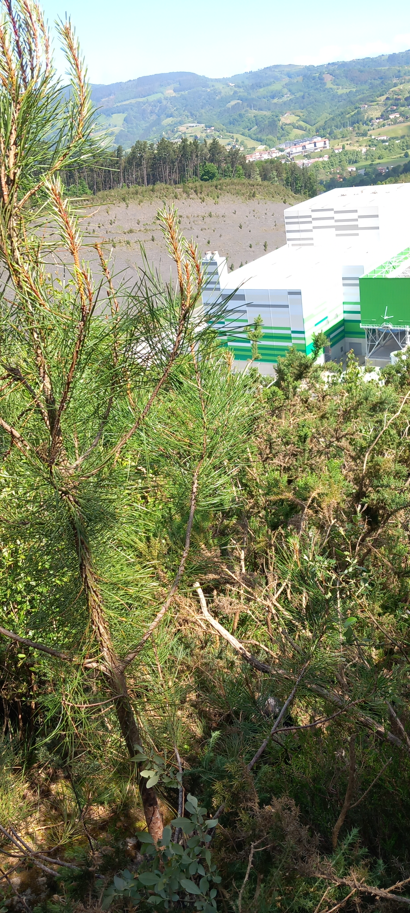
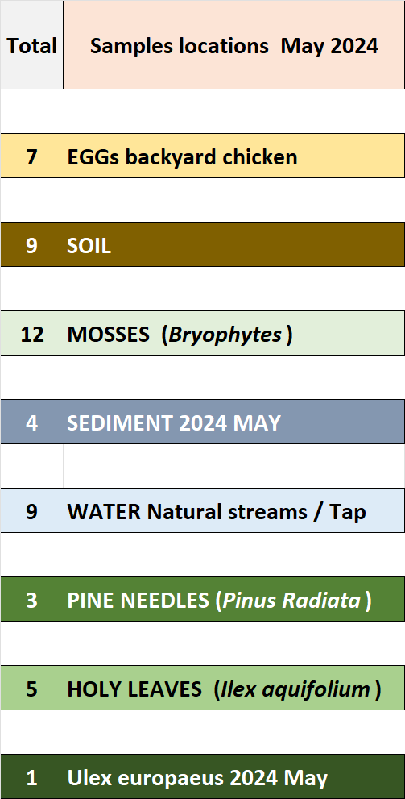
Sample locations Biomonitoring Zubieta region, May 2024

